Slide 1
The Bertillion System

Slide 2
Bertillion System
Alphonse Bertillion, of Paris, France, used body measurements as a form of identification.
This was the first scientific system of identification.
Began around 1879

Slide 3
Anthropometry
Anthropometry is based on the measurements of certain bony structures of the body that do not change after maturity
The Bertillion measurements included:
  Standing Height
  Outstretched reach of both arms
  Trunk Height
  Width of the head
  Length of the Head
  Length of Right Ear
  Width of Right Ear
  Length of Left Foot
  Length of Left Middle Finger
  Length of Left Little Finger
  Length of Left Forearm

Slide 4
Bertillion Measurements
System was used to identify people based on their individual measurements.
Bertillion believed that no two people would have the same measurements.
Cards were printed for each individual with their measurements and a fingerprint.

Slide 5
Possible Problems
Relied upon the recorder being exact when making the measurements
If the recorder were tired or inattentive, measurements could fail to identify a person.
Suspects who were drunk, ill, or uncooperative would also result in inaccurate measurements.

Slide 6
The Downfall of The Bertillion System
The Bertillion system was used for over thirty years until approximately 1903
The Will West case caused an upset in the system

Slide 7
The West Case
In 1903, a prisoner by the name of Will West was sentenced to incarceration at the United States Penitentiary at Leavenworth, Kansas.
During his inprocessing, the records clerk obtained Will West’s Bertillion measurements and photograph.
Will West denied ever being incarcerated at the facility.
The records clerk doubted this information, and referenced his Bertillion measurements into the system, retrieving the Bertillion card for a William West.

Slide 8
The West Case Continued
Will West continued to deny that the William West card was his.
Subsequent investigation disclosed that William West was already incarcerated in the facility as of September 9, 1901, serving a life sentence.
By examining the photographs, one can see the failure of the Bertillion system.
Compare the Bertillion measurements in particular, keeping in mind the various factors that would affect the measurements.
Recent opinions suggest that Will and William West were related, therefore the closeness in measurements, however this is not a definite fact.

Slide 9
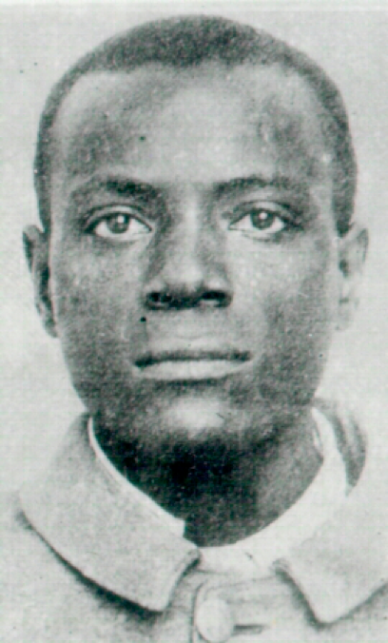
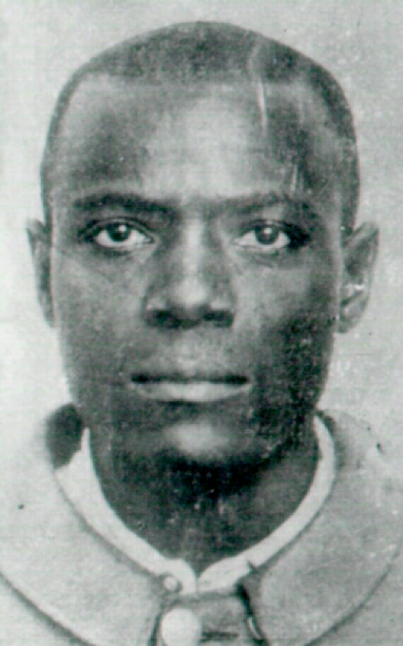
Will & William West
Will West William West
178.5; 187.0; 91.2; 19.7; 15.8; 14.8; 6.6; 28.2; 12.3; 9.7 177.5; 188.0; 91.3; 19.8; 15.9; 14.8; 6.5; 27.5; 12.2; 9.6

Slide 10
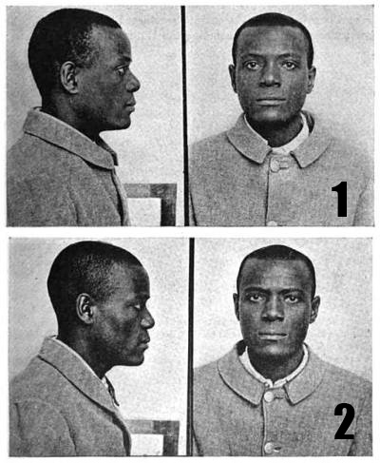
The West Brothers

Slide 11
Now What???
The failure in the system strengthened the science of fingerprints as the normally accepted method of personal identification.

