Slide 1
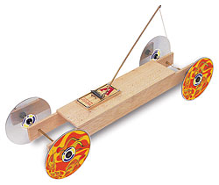
Mousetrap Cars

Slide 2
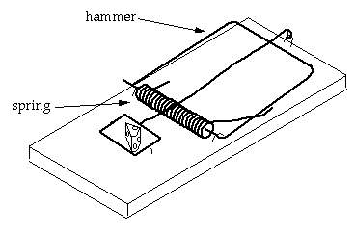
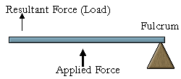
What is a Mousetrap Car?
A vehicle powered by the spring device of a mousetrap
The mousetrap acts as a third-class lever
resultant force (load)
applied force
fulcrum
Notes:
2

Slide 3
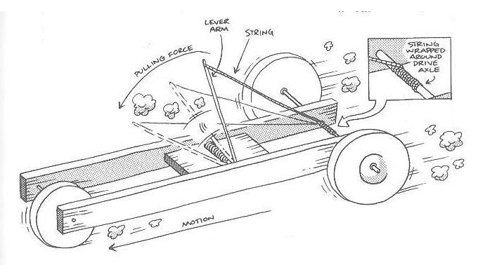
What is a Mousetrap Car?
How does the power source work?
The spring propels the hammer, which causes an enormous release of energy
The hammer is connected to a string that is wound around the drive axle
The string unwinds as the hammer snaps– making the car roll!
(from Doc Fizzix’s Mousetrap Powered Cars & Boats)

Slide 4
Scientific Concepts
Potential Energy: energy that is stored within an object, not in motion but capable of becoming active
You have stored potential energy (in the spring) when your mousetrap is set and ready to be released
Kinetic Energy: energy that a body possesses as a result of its motion
Potential energy becomes kinetic energy as the mousetrap car begins to move
Some of this energy goes to friction– the rest makes your car go!

Slide 5
Scientific Concepts
Force: an action that causes a mass to accelerate
To change the motion of your mousetrap car, you must apply a force
To increase the acceleration of you car, you must increase the force or decrease the mass (Newton’s Second Law)
Friction: the force that opposes the relative motion of two surfaces in contact
Friction will slow– and eventually stop– your mousetrap car
Friction occurs between the wheels and the floor and between the axle and the chassis

Slide 6
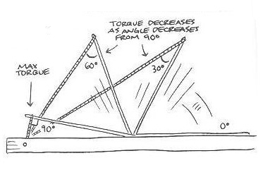
Scientific Concepts
Torque: can informally be thought of as "rotational force" or "angular force" that causes a change in rotational motion
In your mousetrap car, the snapper arm applies a force to the drive axle through the pulling string. This in turn causes a torque to be produced around the drive axle.
Power: the rate at which work is done or energy is used
In a mousetrap car, the same amount of energy is used regardless of its speed – only the rate of use changes
For distance, you want to use energy slowly; for speed, you want to use it more quickly
(from Doc Fizzix’s Mousetrap Powered Cars & Boats)

Slide 7
Construction Hints
When building a mousetrap car, there are a number of variables to consider
Weight of the car
Placement of the mousetrap
Length of the snapper arm and the string
Size and type of wheels
Wheel-to-axle ratio
Your design decisions will depend on the goal of your car: distance or power

Slide 8
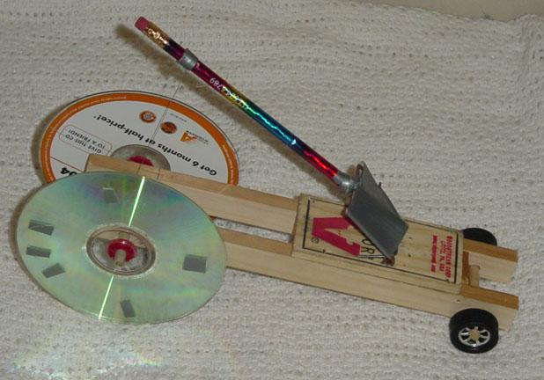
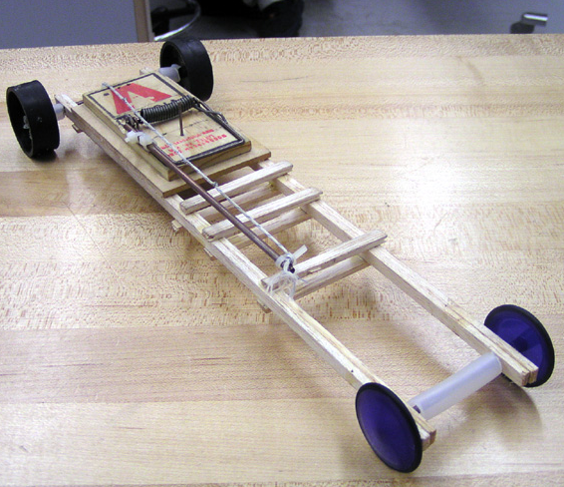
Different designs...
...different goals!

Slide 9
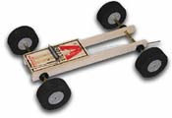
Weight of the Car
For all cars, you want to build the lightest possible vehicle
Lighter vehicles will require less force to begin moving and will experience less friction than heavier vehicles
However, if your car is too light, it will not have enough traction
This will cause the wheels will spin out as soon as the trap is released
Notes:
9

Slide 10
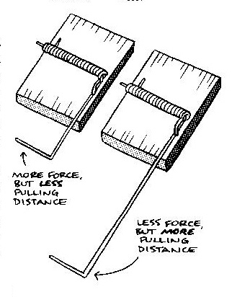
Length of the Snapper Arm and the String
Long snapper arms and short snapper arms release the same amount of energy
The difference lies in the rate at which the energy is released (power output)
For distance cars, try a long arm. Longer arms will provide less force, but more distance.
With a longer arm, more string will be pulled off the axle
This causes the wheels to turn more times and allows the vehicle to cover more distance
For power cars, try a shorter arm. Shorter arms will provide more force and power output, but less distance.
These cars need the power to get up the ramp!
(from Doc Fizzix’s Mousetrap Powered Cars & Boats)

Slide 11
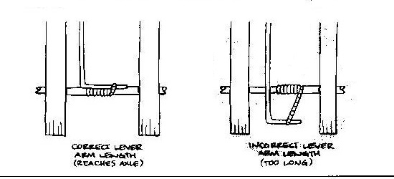
Length of the Snapper Arm and the String (cont.)
For all cars, the lever arm should just reach the drive axle when it’s in the ready position
When the string is wound, the place where the string is attached to the snapper arm should be above the drive axle
This will maximize your torque as your car takes off (maximum torque occurs when your lever arm and string form a 90° angle)
Correct length
Too long!
(from Doc Fizzix’s Mousetrap Powered Cars & Boats)

Slide 12
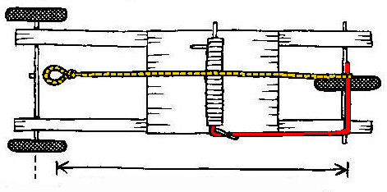
Length of the Snapper Arm and the String (cont.)
The string length should be a little shorter than the distance from the lever arm to the drive axle when the trap is in the relaxed position
This will allow the string to release from the hook– and prevent tangles!
(from Doc Fizzix’s Mousetrap Powered Cars & Boats)
Notes:
12

Slide 13
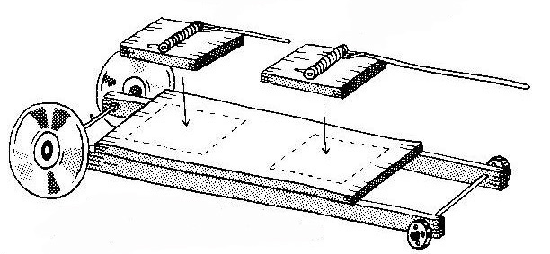
Placement of the Mousetrap
For distance cars, place the trap farther from the drive axle
You’ll sacrifice pulling force, but get more distance
For power cars, place the trap closer to the drive axle
You’ll sacrifice distance, but get more pulling force
Power placement
Drive axle
Distance placement
(from Doc Fizzix’s Mousetrap Powered Cars & Boats)

Slide 14
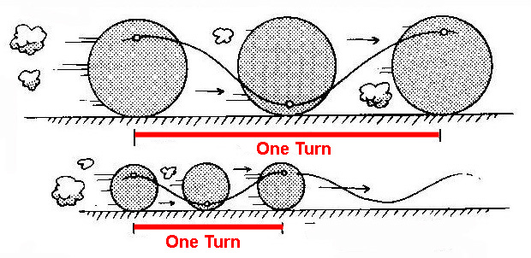
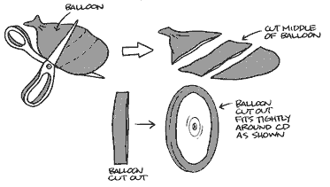
Size and Type of Wheels
For distance cars, larger wheels will cover more distance per rotation than smaller wheels
For power cars, make sure your wheels have good traction so they don’t slip
You can increase traction by covering the edges of the wheel with a rubber band or the middle of a balloon
(from Doc Fizzix’s Mousetrap Powered Cars & Boats)

Slide 15
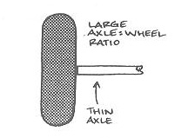
Wheel-to-Axle Ratio
For distance cars, a large wheel-to-axle ratio is best
A large wheel with a small axle will cover more distance each time the axle turns
For power vehicles, a smaller wheel-to-axle ratio is best
Increasing the size of the axle will decrease the wheel-to-axle ratio
This will increase the torque and give you more pulling force for every turn of the wheel
(from Doc Fizzix’s Mousetrap Powered Cars & Boats)
(from Doc Fizzix’s Mousetrap Powered Cars & Boats)

