Slide 1
Introduction to
Simple Machines

Slide 2
Simple Machines
Mechanical device that changes direction or magnitude of force
Use mechanical advantage (or leverage) to multiply force
A single applied force (effort force) does work against a single load force (resistance force)
Examples of Simple Machines:
  Lever
    Wheel and Axle
    Pulley
  Inclined Plane
    Wedge
    Screw

Slide 3
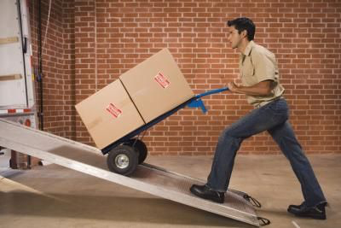
Inclined Plane
A flat surface set at an angle or incline with no moving parts
Able to lift objects by pushing or pulling the load

Slide 4
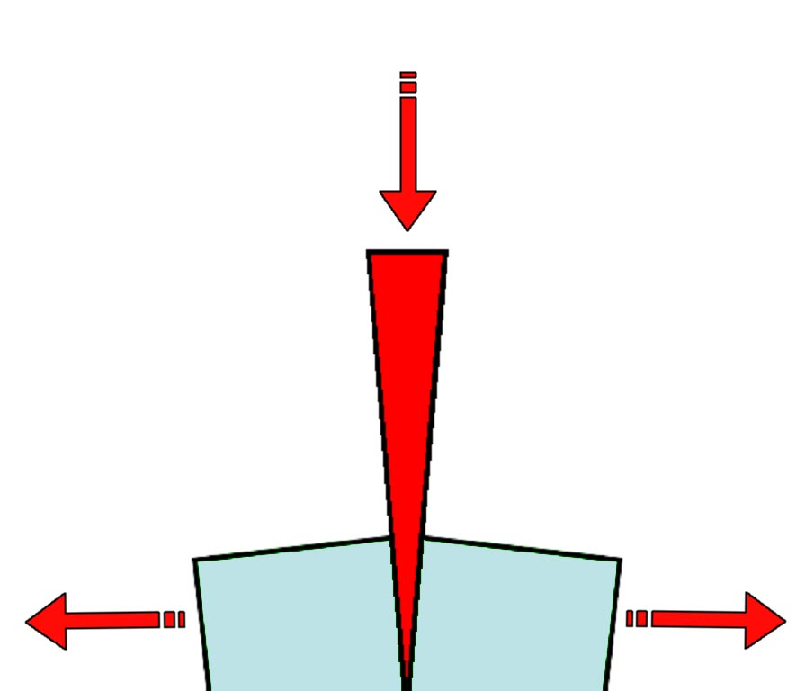
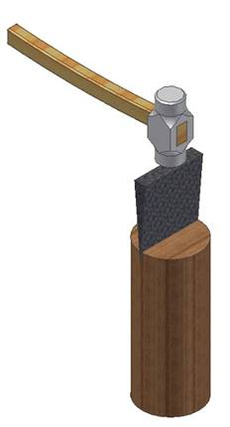
Wedge
Functions as a moving inclined plane
Tapers to a thin edge and is used for splitting, raising heavy bodies by separating them from the surface they rest on, or for tightening by being driven into something

Slide 5
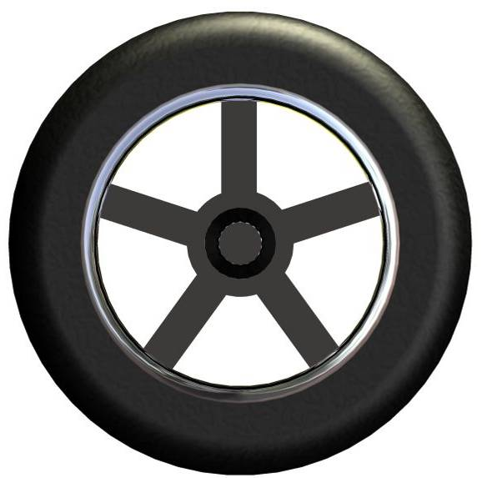
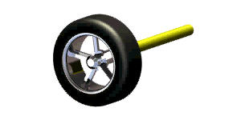
Wheel and Axle
A wheel is a lever arm that is fixed to a shaft, which is called an axle.
The wheel and axle move together as a simple lever to lift or to move an item by rolling.
It is important to know within the wheel and axle system which is applying the effort and resistance force – the wheel or the axle.

Slide 6
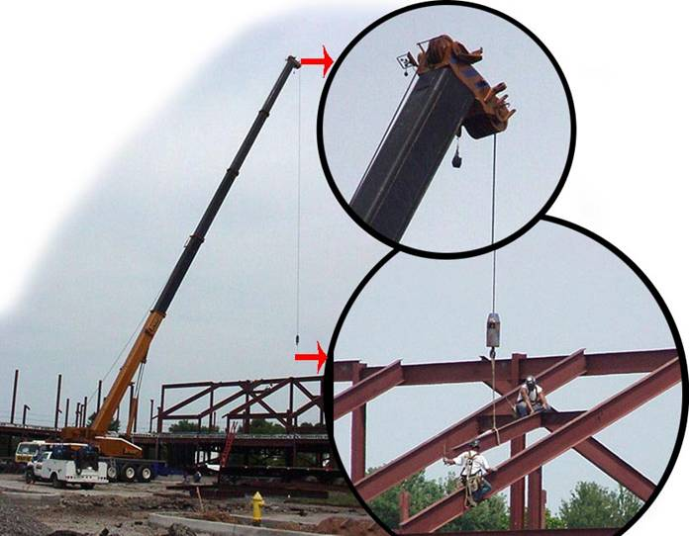
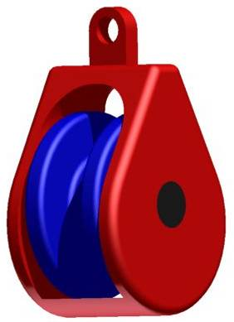
Pulley
A pulley is a lever consisting of a wheel with a groove in its rim which is used to change the direction and magnitude of a force exerted by a rope or cable.

Slide 7
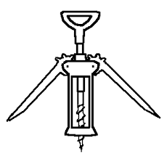
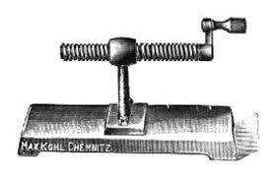
Screw
A mechanism that changes rotary motion into linear motion

Slide 8
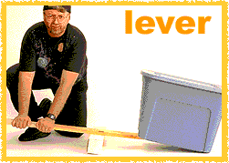
Lever
A mechanism that rotates about a fulcrum to lift a heavy load.

Slide 9
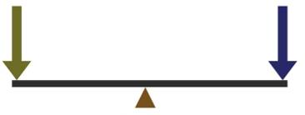
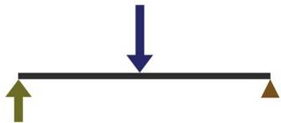
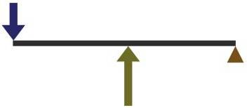
Resistance
Resistance
Effort
MA =1
First class
Fulcrum in middle
Effort
Second class
Load/Resistance in middle
Resistance
Third class
Effort in middle
Effort

Slide 10
Remember…
FRE
1st class
3rd class
2nd class

Slide 11







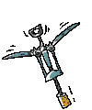




Levers Quiz
Use the following slides to quiz yourself on how how well you can match commonly used items with their correct class of lever.
You will hear applause if your answer is correct

Slide 12
Click on the correct Lever classification for the tool pictured below.
First Class
Second Class
Third Class

Slide 13
Click on the correct Lever classification for the tool pictured below.
First Class
Second Class
Third Class

Slide 14
Click on the correct Lever classification for the tool pictured below.
First Class
Second Class
Third Class

Slide 15
Click on the correct Lever classification for the tool pictured below.
First Class
Second Class
Third Class

Slide 16
Click on the correct Lever classification for the tool pictured below.
First Class
Second Class
Third Class

Slide 17
First Class
Second Class
Third Class

Slide 18
Click on the correct Lever classification for the tool pictured below.
First Class
Second Class
Third Class

Slide 19
Click on the correct Lever classification for the tool pictured below.
First Class
Second Class
Third Class

Slide 20
Click on the correct Lever classification for the tool pictured below.
First Class
Second Class
Third Class

Slide 21
Click on the correct Lever classification for the tool pictured below.
First Class
Second Class
Third Class

Slide 22
Click on the correct Lever classification for the tool pictured below.
First Class
Second Class
Third Class

Slide 23
Click on the correct Lever classification for the tool pictured below.
First Class
Second Class
Third Class

Slide 24
Click on the correct Lever classification for the tool pictured below.
First Class
Second Class
Third Class

Slide 25
Click on the correct Lever classification for the tool pictured below.
First Class
Second Class
Third Class

Slide 26
Congratulations!
You have successfully matched the common hand tools with their correct classification of lever. Be sure to remember:
F R E
1 2 3

