Slide 1
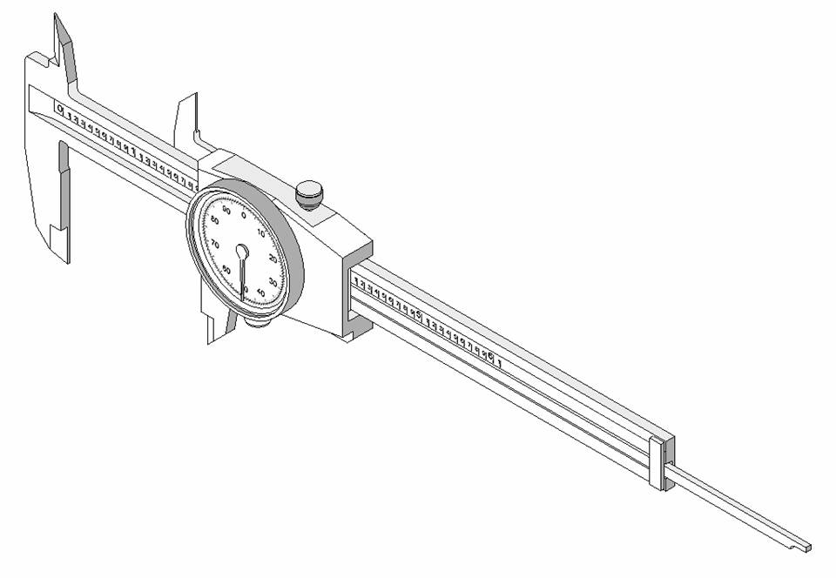
Dial Calipers
Notes:
Dial Calipers
Project Lead The Way, Inc.
Copyright 2007
1
Design and Drawing for Production
Unit 1 – Lesson 1.3 – Measurement and Statistics

Slide 2
Dial Calipers
General Information
Notes:
Dial Calipers
Project Lead The Way, Inc.
Copyright 2007
2
Design and Drawing for Production
Unit 1 – Lesson 1.3 – Measurement and Statistics
At the conclusion of this presentation, you will be able to…
identify four types of measurements that dial calipers can perform.
identify the different parts of a dial caliper.
accurately read an inch dial caliper.

Slide 3
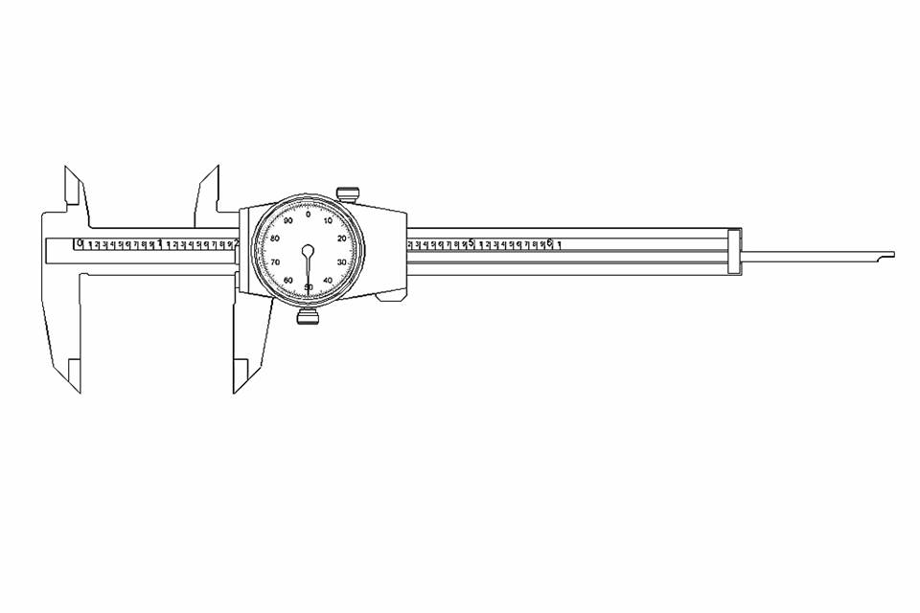
Dial Calipers are arguably the most common and versatile of all the precision measuring tools used by engineers and manufacturers.
Notes:
Dial Calipers
Project Lead The Way, Inc.
Copyright 2007
3
Design and Drawing for Production
Unit 1 – Lesson 1.3 – Measurement and Statistics
Regardless of what type of caliper you use, be sure to take the following precautions to avoid damaging the caliper:
1. Wash your hands before you handle the dial caliper to remove dirt and oils that might damage the caliper.
2. Wipe the caliper components clean both before and after you use the caliper.
3. Do NOT drop or otherwise mishandle the caliper. Doing so may damage or destroy the caliper.

Slide 4
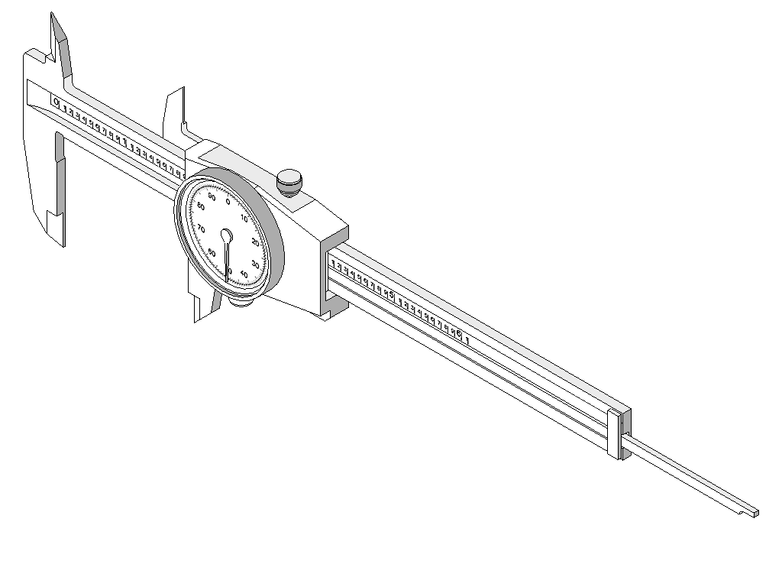
Dial Calipers
Four Types of Measurements
Notes:
Dial Calipers
Project Lead The Way, Inc.
Copyright 2007
4
Design and Drawing for Production
Unit 1 – Lesson 1.3 – Measurement and Statistics

Slide 5
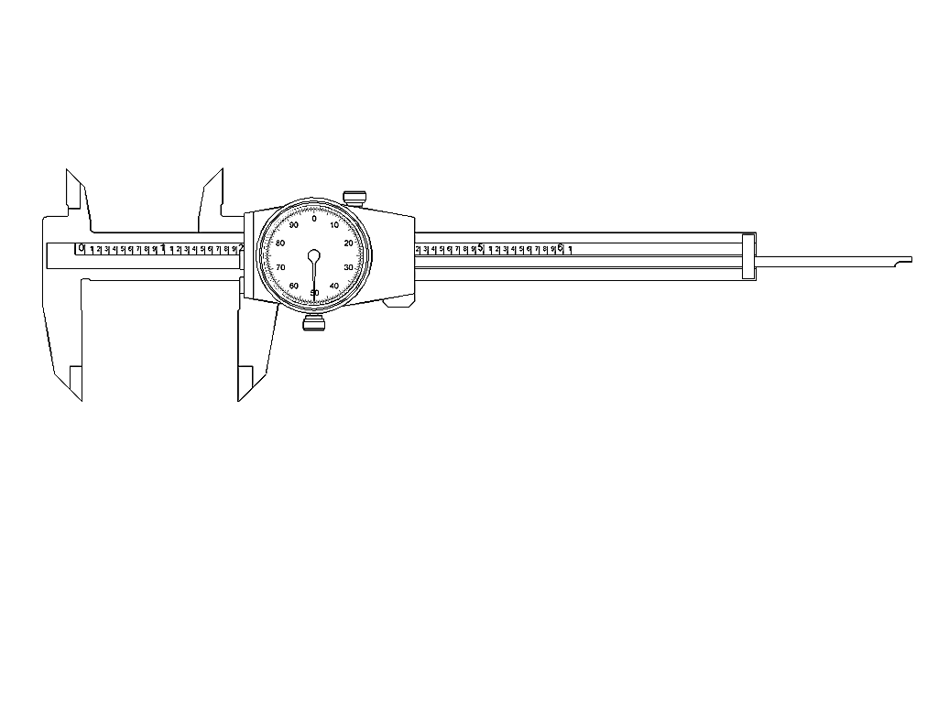
Dial calipers are used to perform four common measurements on parts…
Notes:
Dial Calipers
Project Lead The Way, Inc.
Copyright 2007
5
Design and Drawing for Production
Unit 1 – Lesson 1.3 – Measurement and Statistics

Slide 6
Outside Diameter or Object Thickness
Inside Diameter or Space Width
Step Distance
Hole Depth
Notes:
Dial Calipers
Project Lead The Way, Inc.
Copyright 2007
6
Design and Drawing for Production
Unit 1 – Lesson 1.3 – Measurement and Statistics

Slide 7
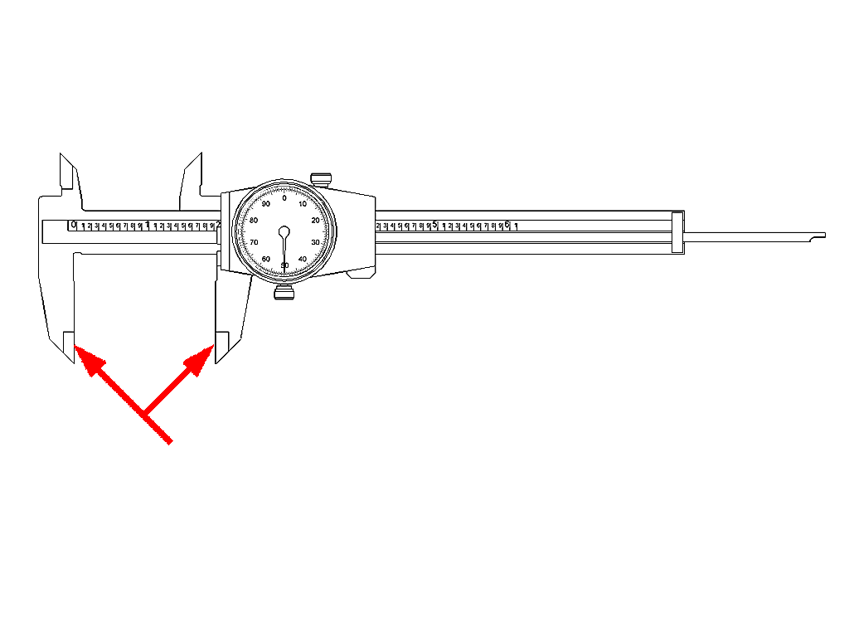
Outside Measuring Faces
These are the faces between which outside length or diameter is measured.
Notes:
Dial Calipers
Project Lead The Way, Inc.
Copyright 2007
7
Design and Drawing for Production
Unit 1 – Lesson 1.3 – Measurement and Statistics

Slide 8
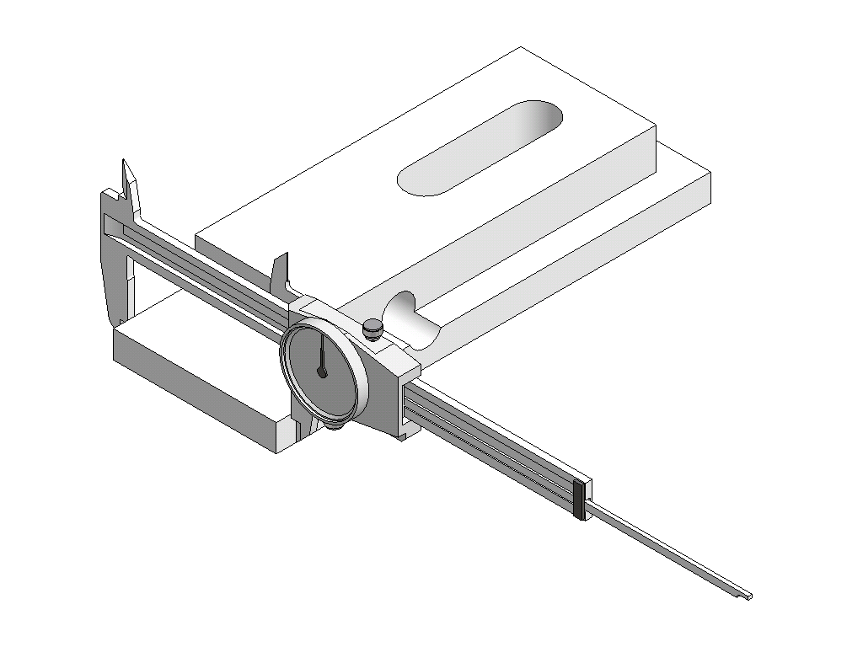
Example: Outside Diameter of object
Notes:
Dial Calipers
Project Lead The Way, Inc.
Copyright 2007
8
Design and Drawing for Production
Unit 1 – Lesson 1.3 – Measurement and Statistics

Slide 9
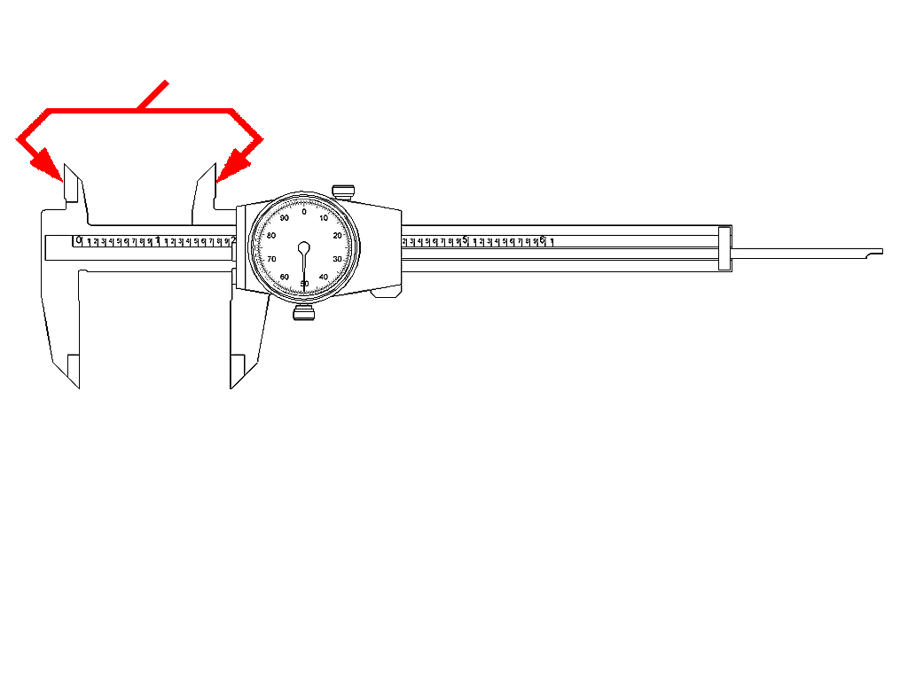
Inside Measuring Faces
These are the faces between which inside diameter or space width (i.e., slot width) is measured.
Notes:
Dial Calipers
Project Lead The Way, Inc.
Copyright 2007
9
Design and Drawing for Production
Unit 1 – Lesson 1.3 – Measurement and Statistics

Slide 10
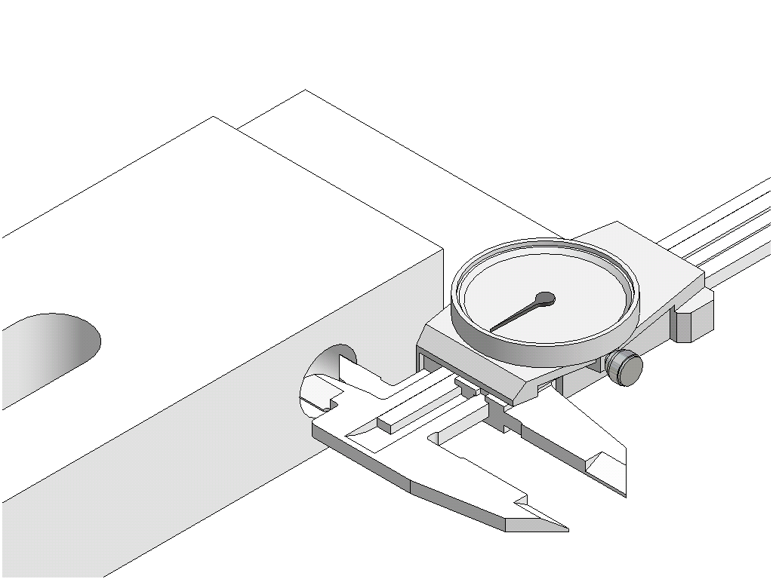
Example: Inside measuring
Notes:
Dial Calipers
Project Lead The Way, Inc.
Copyright 2007
10
Design and Drawing for Production
Unit 1 – Lesson 1.3 – Measurement and Statistics

Slide 11
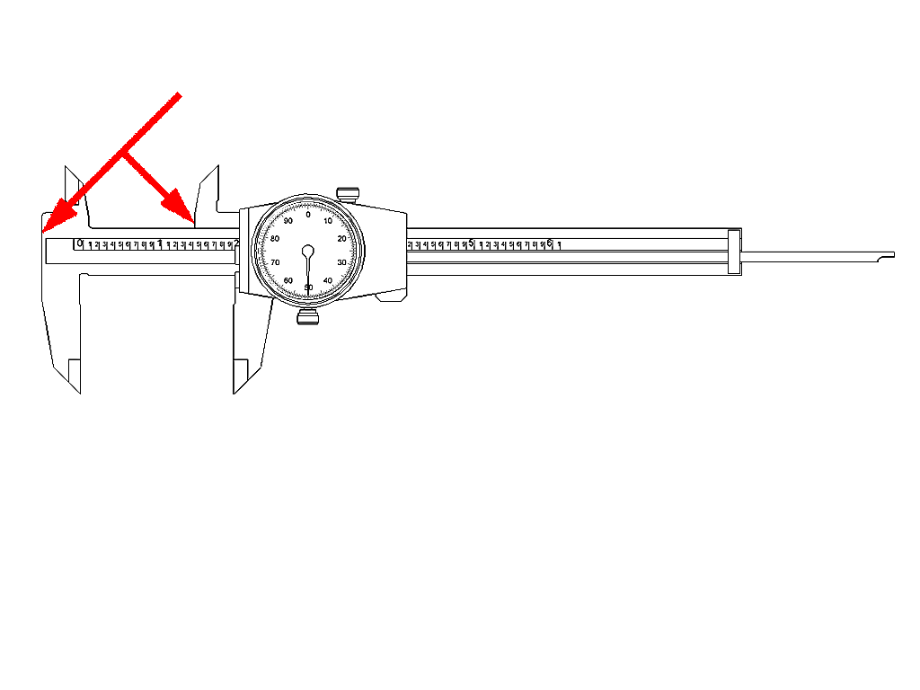
Step Measuring Faces
These are the faces between which stepped parallel surface distance can be measured.
Notes:
Dial Calipers
Project Lead The Way, Inc.
Copyright 2007
11
Design and Drawing for Production
Unit 1 – Lesson 1.3 – Measurement and Statistics

Slide 12
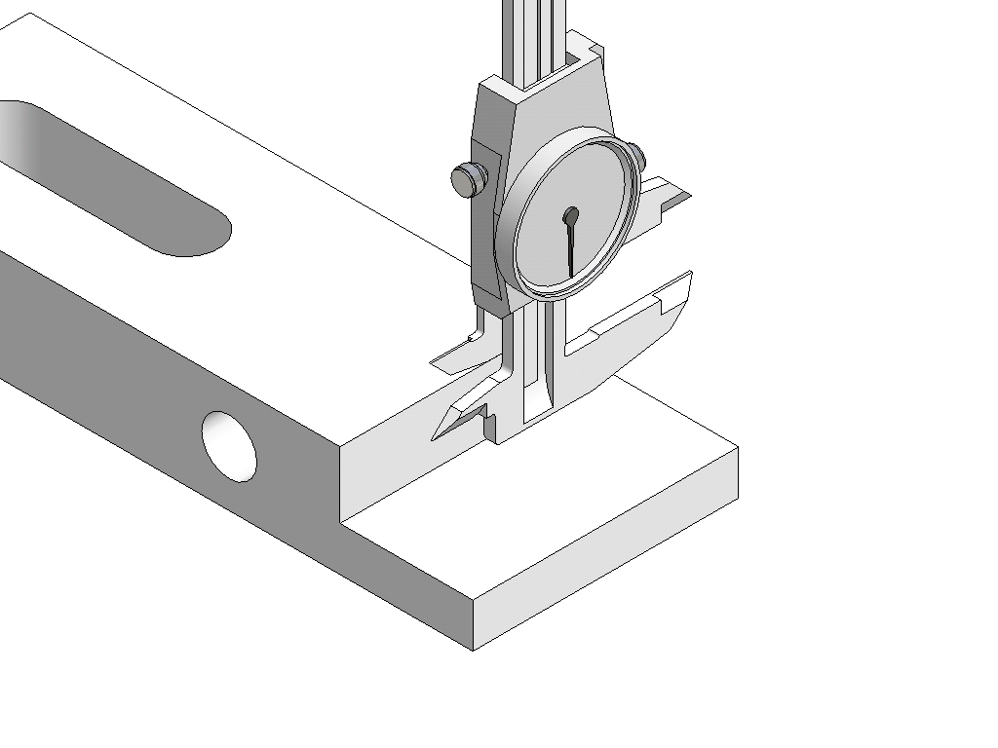
Example: Step Distance
Notes:
Dial Calipers
Project Lead The Way, Inc.
Copyright 2007
12
Design and Drawing for Production
Unit 1 – Lesson 1.3 – Measurement and Statistics

Slide 13
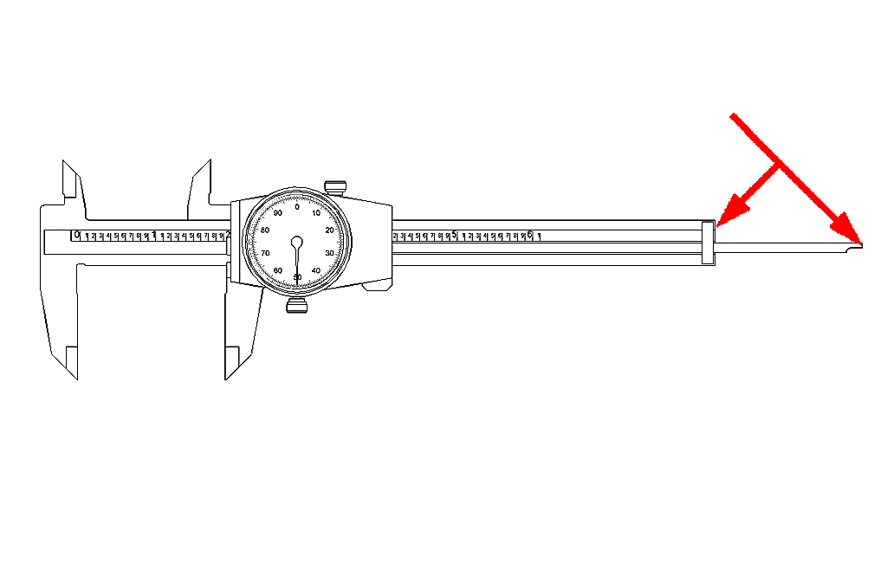
Depth Measuring Faces
These are the faces between which the depth of a hole can be measured.
Notes:
Dial Calipers
Project Lead The Way, Inc.
Copyright 2007
13
Design and Drawing for Production
Unit 1 – Lesson 1.3 – Measurement and Statistics

Slide 14
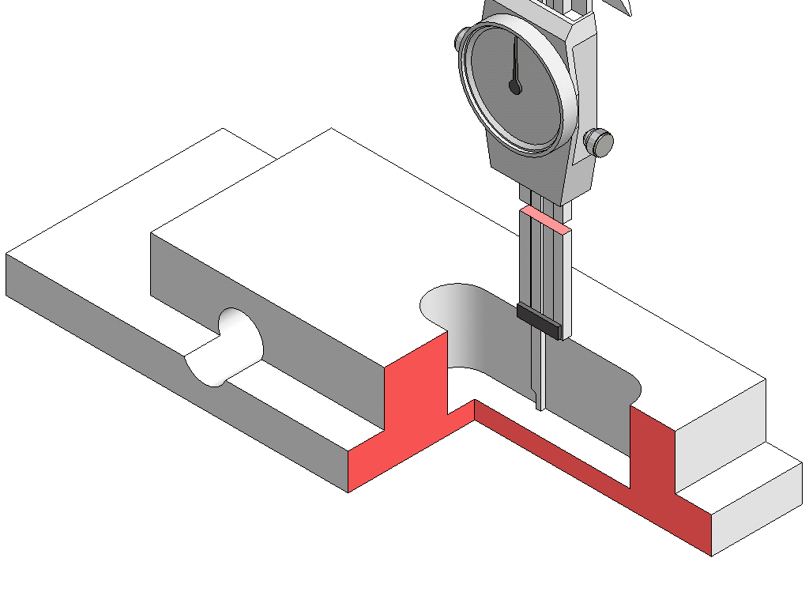
Example: Depth Measuring
Note: Work piece is shown in section. Dial Caliper shortened for graphic purposes.
Notes:
Dial Calipers
Project Lead The Way, Inc.
Copyright 2007
14
Design and Drawing for Production
Unit 1 – Lesson 1.3 – Measurement and Statistics

Slide 15
Dial Calipers
Nomenclature
Notes:
Dial Calipers
Project Lead The Way, Inc.
Copyright 2007
15
Design and Drawing for Production
Unit 1 – Lesson 1.3 – Measurement and Statistics

Slide 16
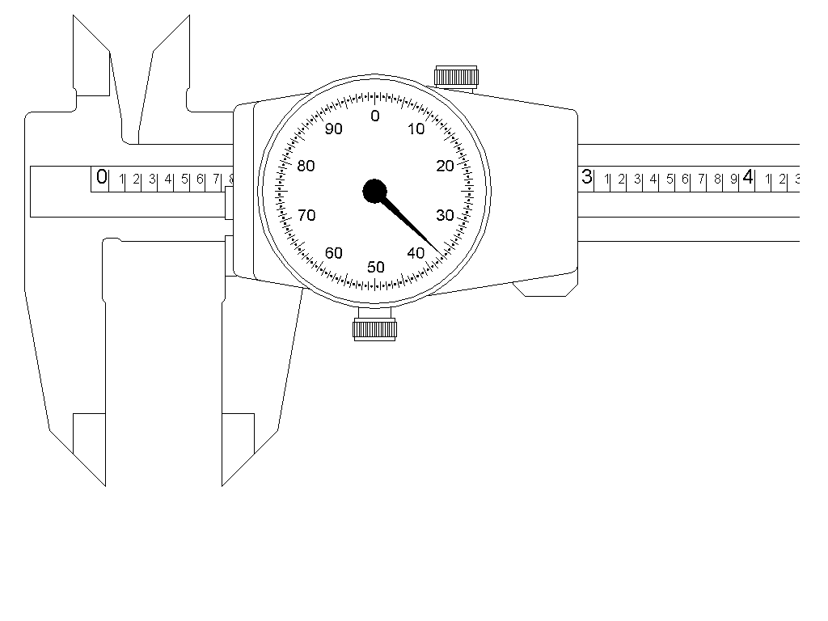
A standard inch dial caliper will measure slightly more than 6 inches.
Notes:
Dial Calipers
Project Lead The Way, Inc.
Copyright 2007
16
Design and Drawing for Production
Unit 1 – Lesson 1.3 – Measurement and Statistics

Slide 17
The blade scale shows each inch divided into 10 increments. Each increment equals one hundred thousandths (0.100”).
Notes:
Dial Calipers
Project Lead The Way, Inc.
Copyright 2007
17
Design and Drawing for Production
Unit 1 – Lesson 1.3 – Measurement and Statistics
Note: Some dial calipers have blade scales that are located above or below the rack

Slide 18
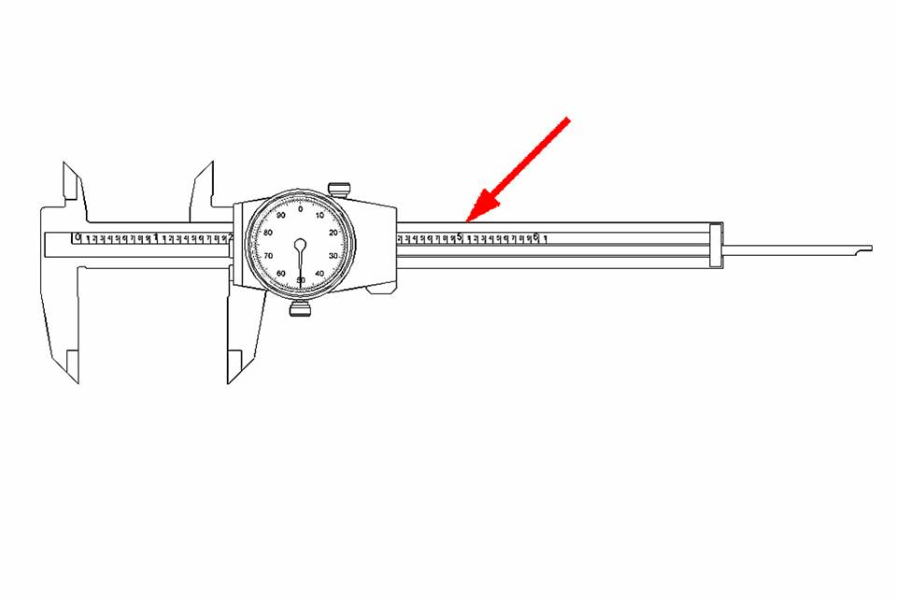
Slider
Blade
The blade is the immovable portion of the dial caliper.
The slider moves along the blade and is used to adjust the distance between the measuring surfaces.
Notes:
Dial Calipers
Project Lead The Way, Inc.
Copyright 2007
18
Design and Drawing for Production
Unit 1 – Lesson 1.3 – Measurement and Statistics

Slide 19
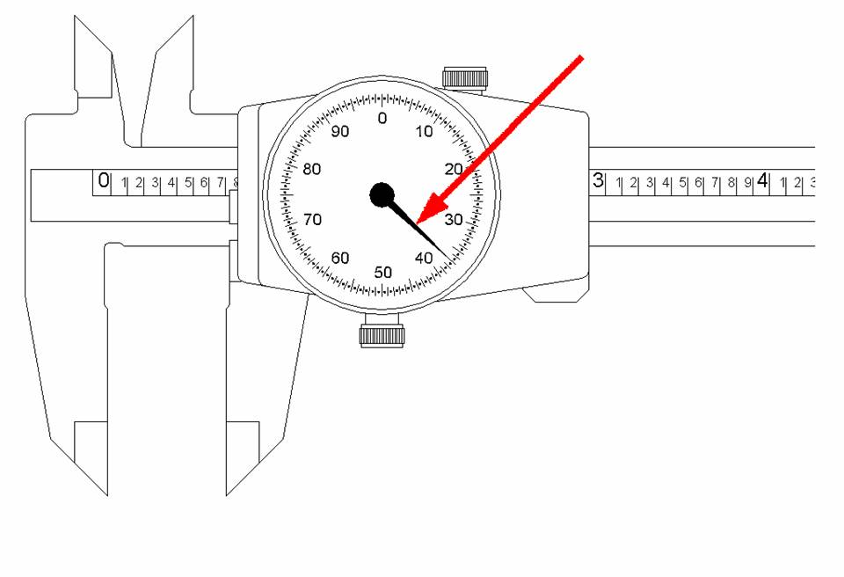
Pointer
The pointer rotates within the dial as the slider moves back-and-forth along the blade.
Notes:
Dial Calipers
Project Lead The Way, Inc.
Copyright 2007
19
Design and Drawing for Production
Unit 1 – Lesson 1.3 – Measurement and Statistics

Slide 20
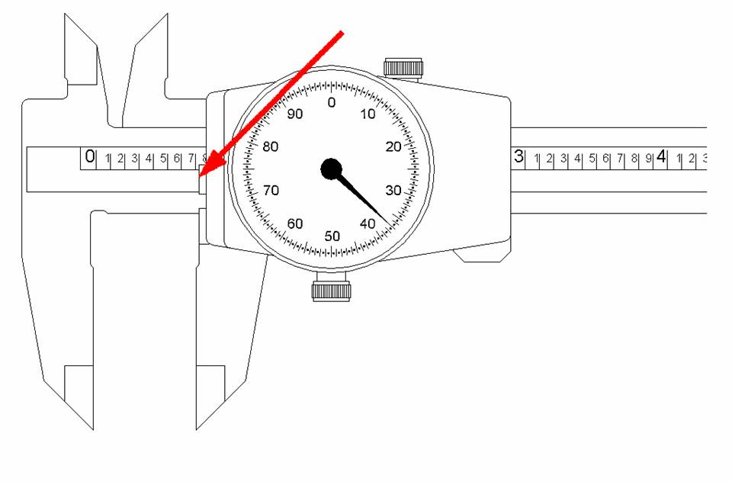
Reference Edge
The reference edge keeps track of the larger increments (i.e. 0.100”) as the slider moves along the rack.
Notes:
Dial Calipers
Project Lead The Way, Inc.
Copyright 2007
20
Design and Drawing for Production
Unit 1 – Lesson 1.3 – Measurement and Statistics

Slide 21
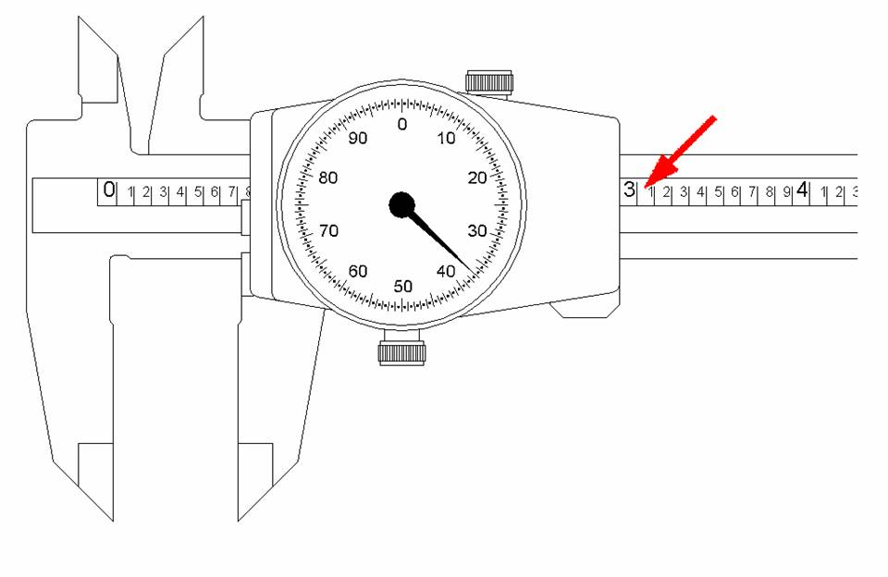
Rack
The gear-toothed rack is used to change linear motion (slider) to rotary motion (pointer).
Notes:
Dial Calipers
Project Lead The Way, Inc.
Copyright 2007
21
Design and Drawing for Production
Unit 1 – Lesson 1.3 – Measurement and Statistics

Slide 22
Dial Calipers
Reading the Inch Dial Caliper
Notes:
Dial Calipers
Project Lead The Way, Inc.
Copyright 2007
22
Design and Drawing for Production
Unit 1 – Lesson 1.3 – Measurement and Statistics

Slide 23
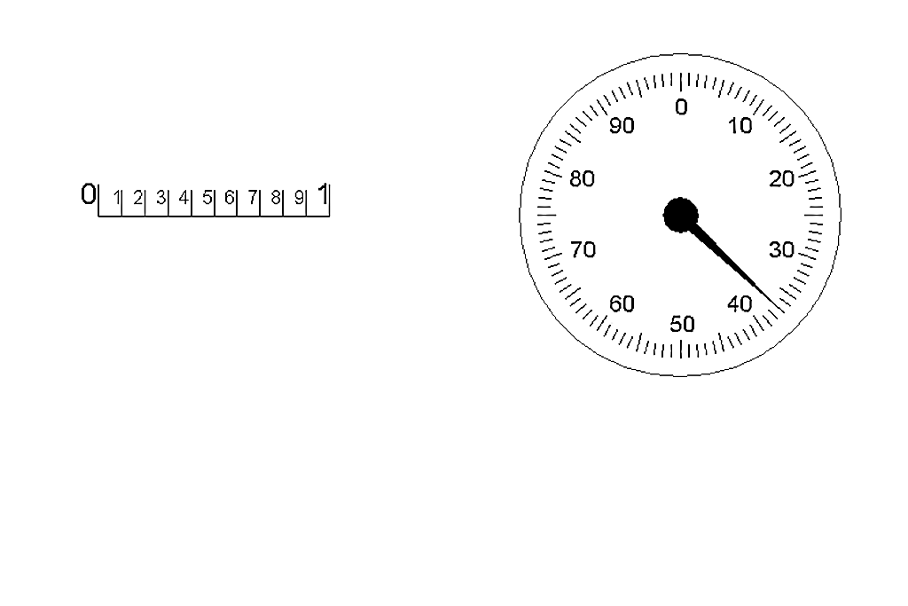
The dial is divided 100 times, with each graduation equaling one thousandth of an inch (0.001”).
Notes:
Dial Calipers
Project Lead The Way, Inc.
Copyright 2007
23
Design and Drawing for Production
Unit 1 – Lesson 1.3 – Measurement and Statistics
Note: Dial face divisions and increments are not standardized.

Slide 24
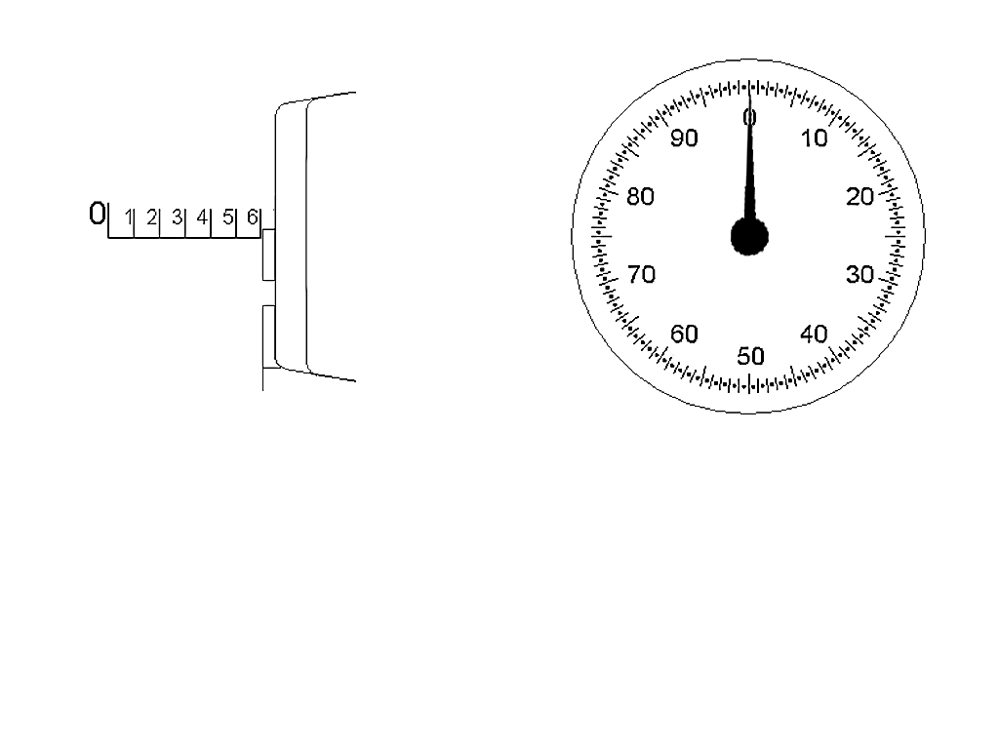
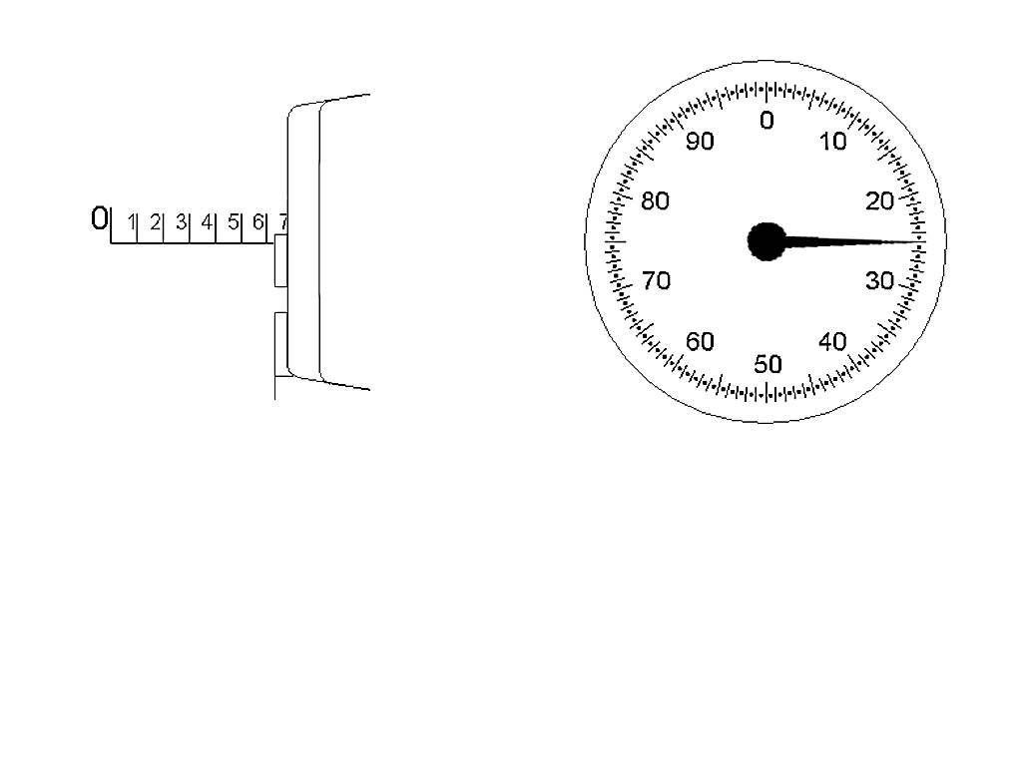
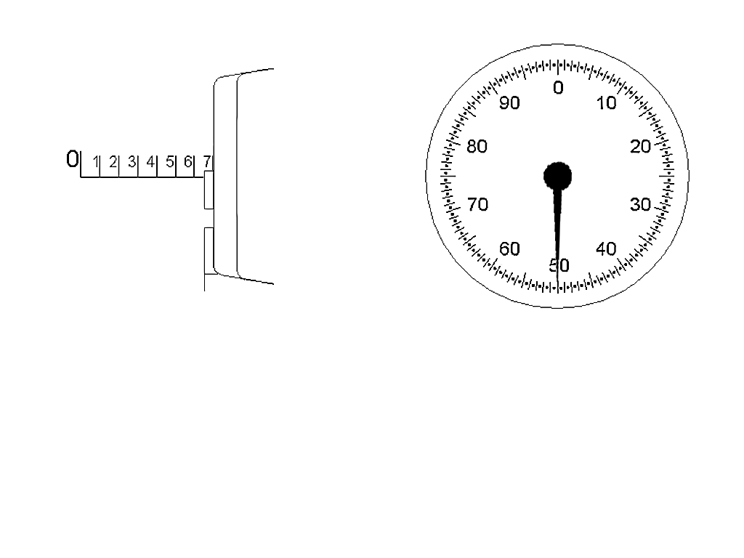
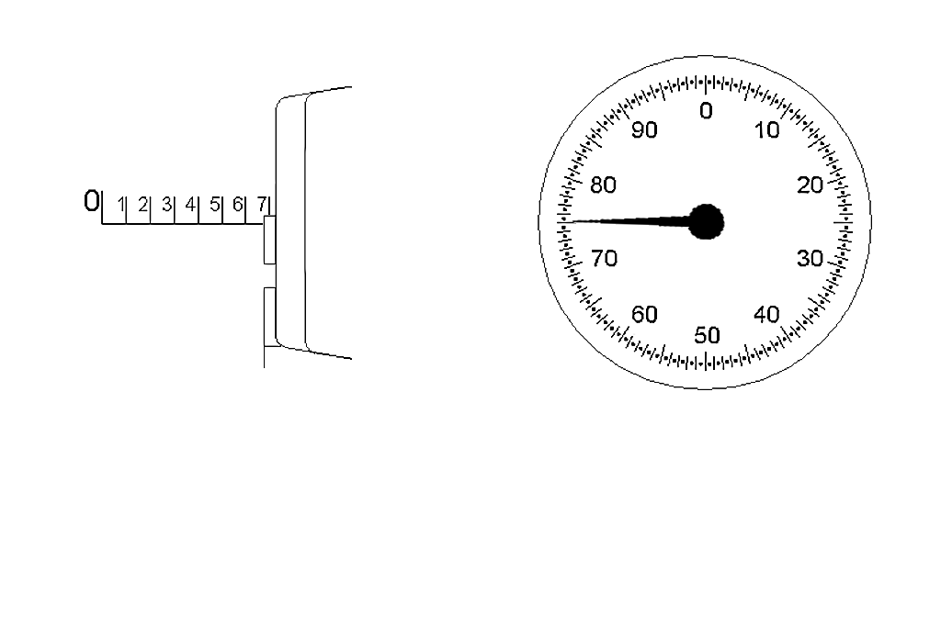
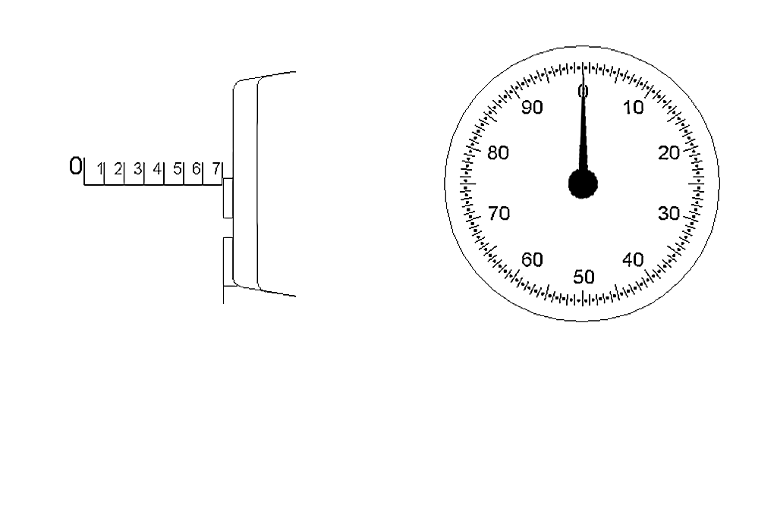
Every time the pointer completes one rotation, the reference edge on the slider will have moved the distance of one blade scale increment (0.100”).
Notes:
Dial Calipers
Project Lead The Way, Inc.
Copyright 2007
24
Design and Drawing for Production
Unit 1 – Lesson 1.3 – Measurement and Statistics

Slide 25
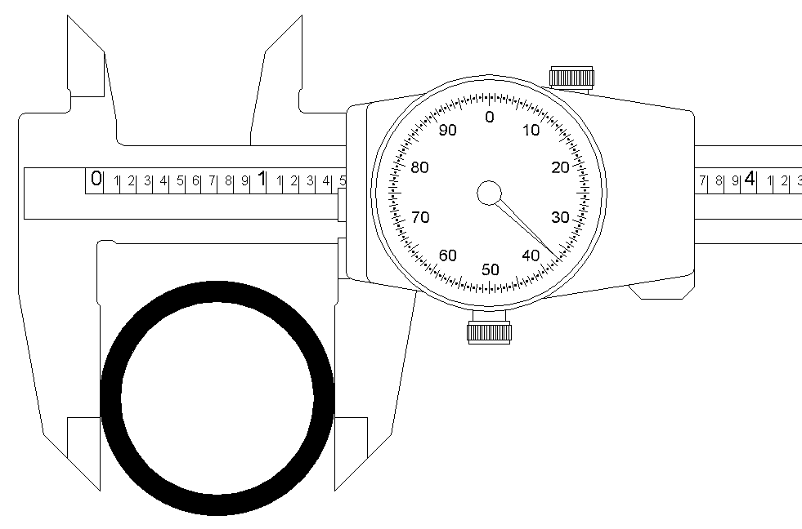
To determine the outside diameter of this pipe section, the user must first identify how many inches are being shown on the blade scale.
Notes:
Dial Calipers
Project Lead The Way, Inc.
Copyright 2007
25
Design and Drawing for Production
Unit 1 – Lesson 1.3 – Measurement and Statistics

Slide 26
1.000”
0.400”
The reference edge is located between the 1 and 2 inch marks. So, the user makes a mental note…1 inch.
The user then identifies how many 0.1” increment marks are showing to the right of the last inch mark.
In this case, there are 4…or 0.400”.
Notes:
Dial Calipers
Project Lead The Way, Inc.
Copyright 2007
26
Design and Drawing for Production
Unit 1 – Lesson 1.3 – Measurement and Statistics

Slide 27
1.000”
0.400”
+
0.037”
1.437”
Next, the user looks at the pointer on the dial to see how many thousandths it is pointing to.
In this case, it is pointing to 37…or 0.037”.
The user then adds the three values together…
Notes:
Dial Calipers
Project Lead The Way, Inc.
Copyright 2007
27
Design and Drawing for Production
Unit 1 – Lesson 1.3 – Measurement and Statistics

Slide 28
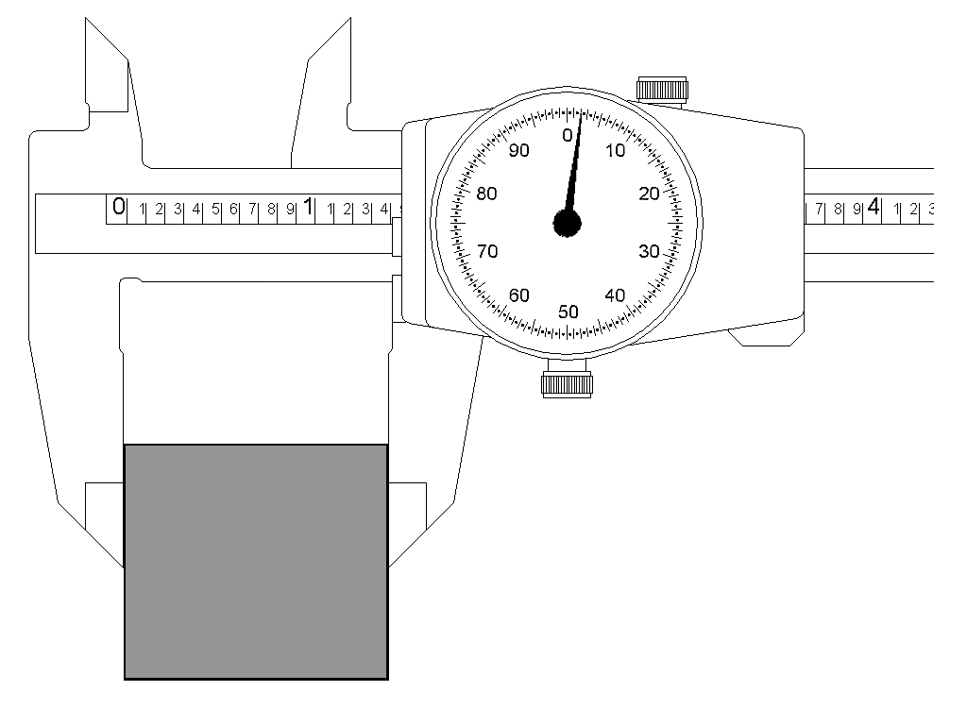
How wide is the block?
Notes:
Dial Calipers
Project Lead The Way, Inc.
Copyright 2007
28
Design and Drawing for Production
Unit 1 – Lesson 1.3 – Measurement and Statistics

Slide 29
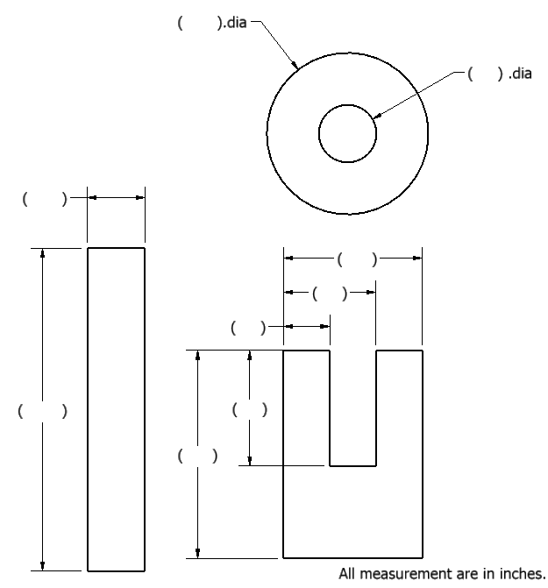
Practice Time
Notes:
Dial Calipers
Project Lead The Way, Inc.
Copyright 2007
29
Design and Drawing for Production
Unit 1 – Lesson 1.3 – Measurement and Statistics
Have students start working on Activity 1.3.3 Dial Calipers. Walk around the room and help students as needed.

